Slide 1
Coupon System
Avishay Hajbi Limor Golan and Elad Silver

Slide 2
System Map
Log In
Add business
Add Coupons
View Coupons
Shopping cart
Buy Coupons
View coupons
Update coupons
Delete coupons
System Administrator
Costumer

Slide 3
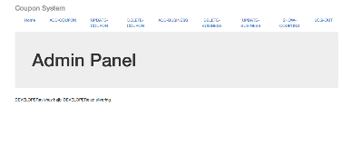
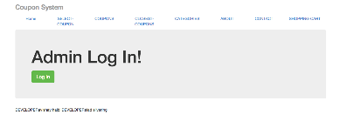
Main User Interface
System Administrator
Costumer

Slide 4
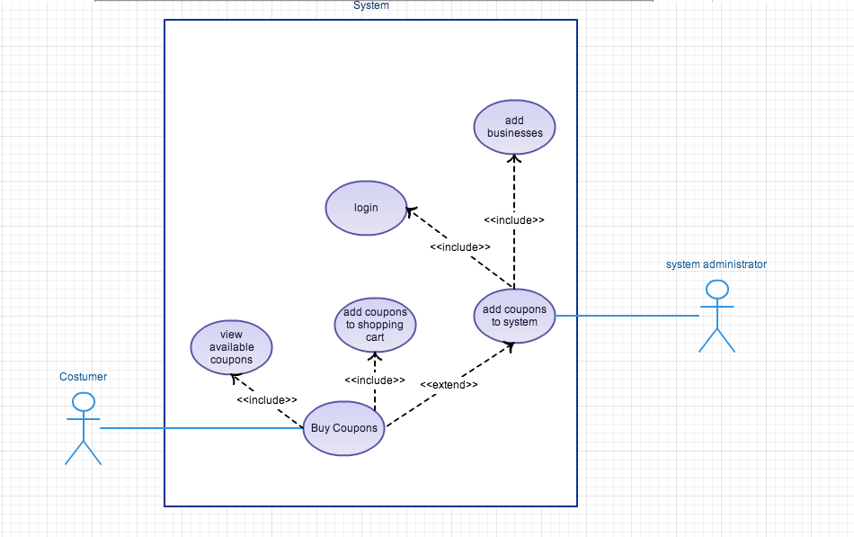
Use Case Diagram

Slide 5
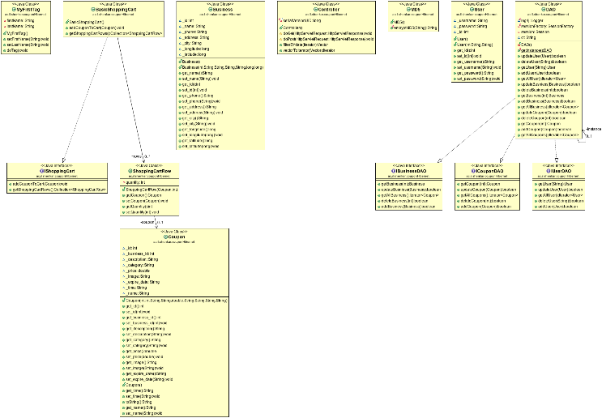
Class Diagram

